Slide 1
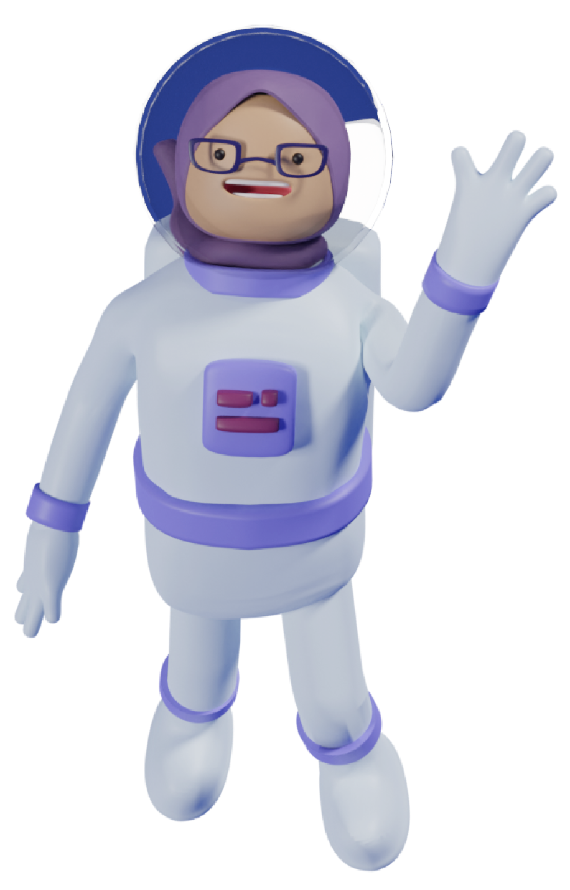
Hello, I'm Besmelh Alshaalan!
Welcome to my space!

Slide 2
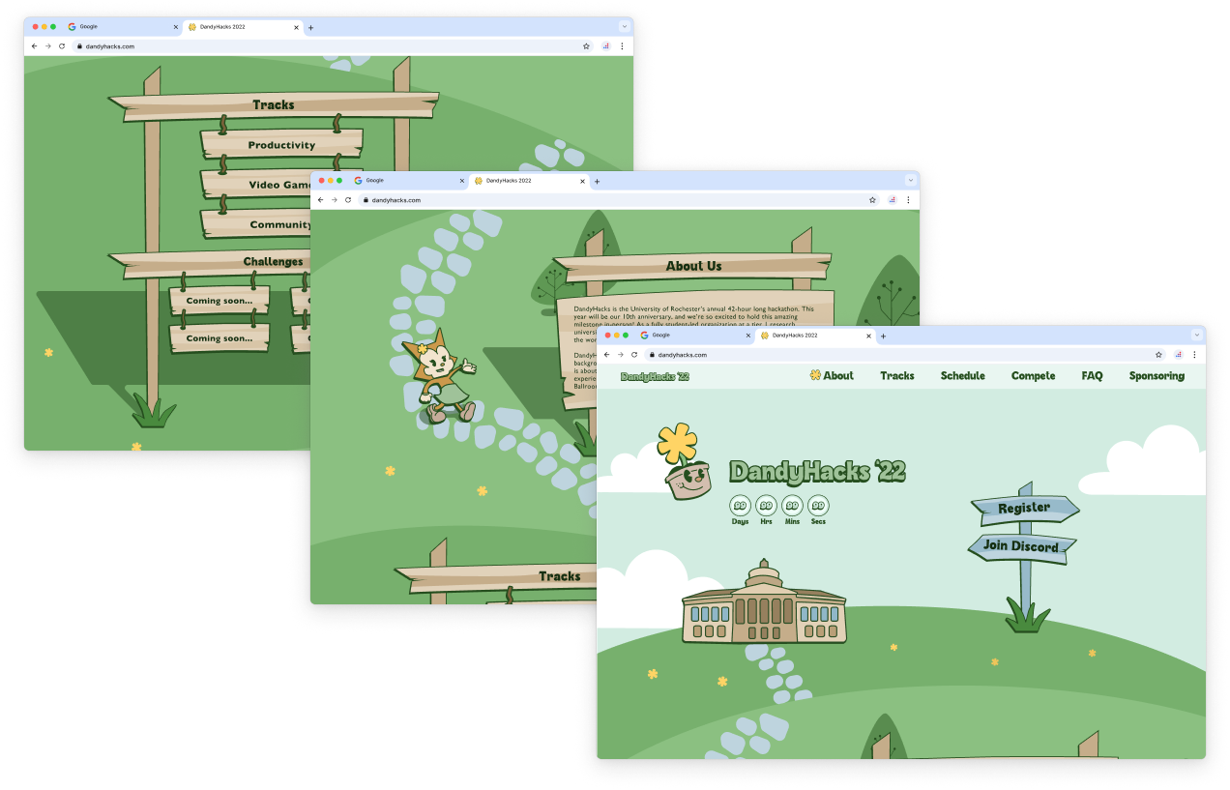
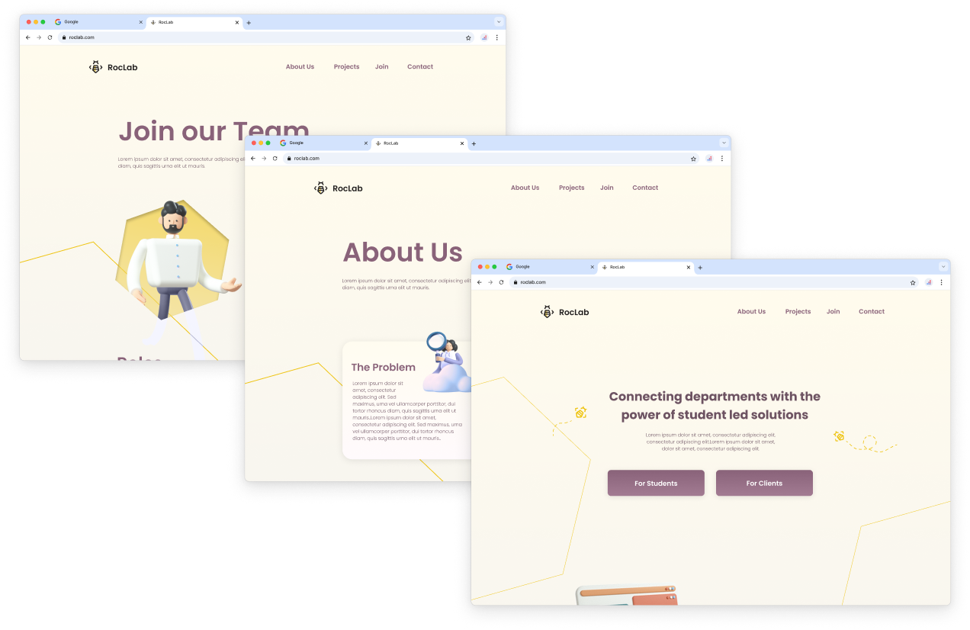
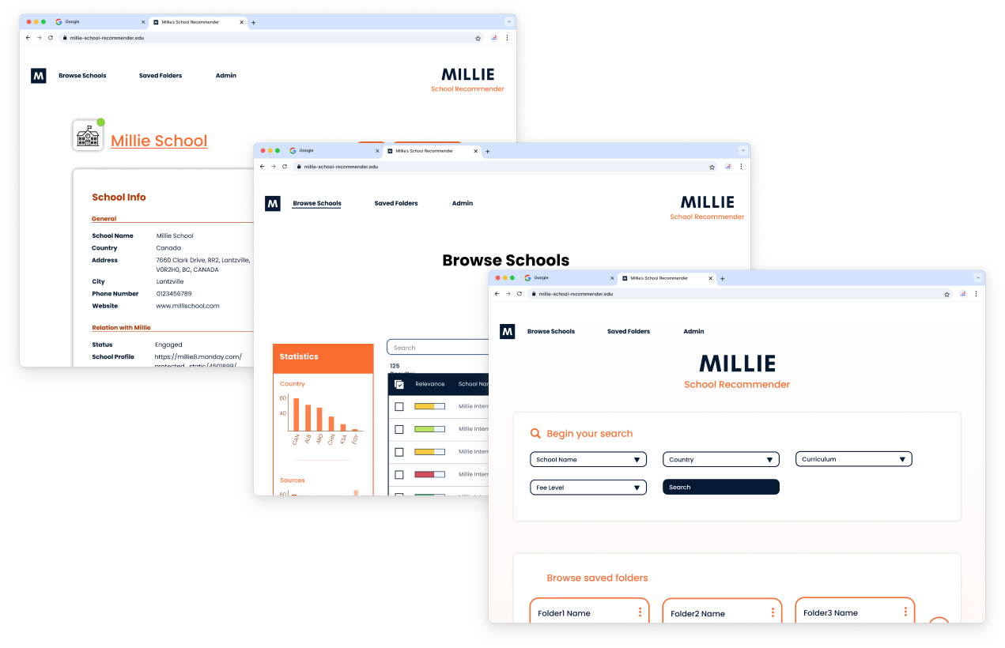
A little about me…
Software Development
Graphic Design
Web Dev. & Design
Game Dev. & Design
UI/UX
Computer Graphics
I've always enjoyed using code to bring engaging visuals to life — blending creativity with logic.
I'm especially interested in how computer graphics power animation, video games, and immersive experiences.
The following are screenshots of some of my website designs. In the next few slides I cover some of my favorite and most relevant projects.

Slide 3

Oil Exploration Game at Saudi Aramco
VR Development & Educational Game Design

Slide 4
Oil Exploration Game at Saudi Aramco
VR Development & Educational Game Design
VR Game Development
Game Design
User Research
Unreal Engine
Task 1: Added functionality to existing VR games.
Added functionalities that use hand tracking.
Developed a reusable VR template to convert Meta (Oculus) games to HTC Vive Focus 3.
Solved hardware/software mismatches, despite limited HTC documentation.
Task 2: Designed a serious game to teach new hires about oil exploration.
Conducted interviews with engineers and educators.
Researched existing educational games and gamification strategies.
Prototyped the concept in Figma.
Got feedback from by team.
Presented the results to stakeholder, and delivered 30% of the game development cycle, ready for production.

Slide 5
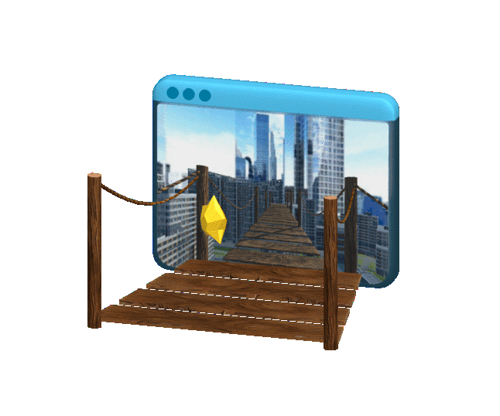
Phobigone
VR game application to help users overcome their phobias (fear of the dark, heights, small spaces).

Slide 6
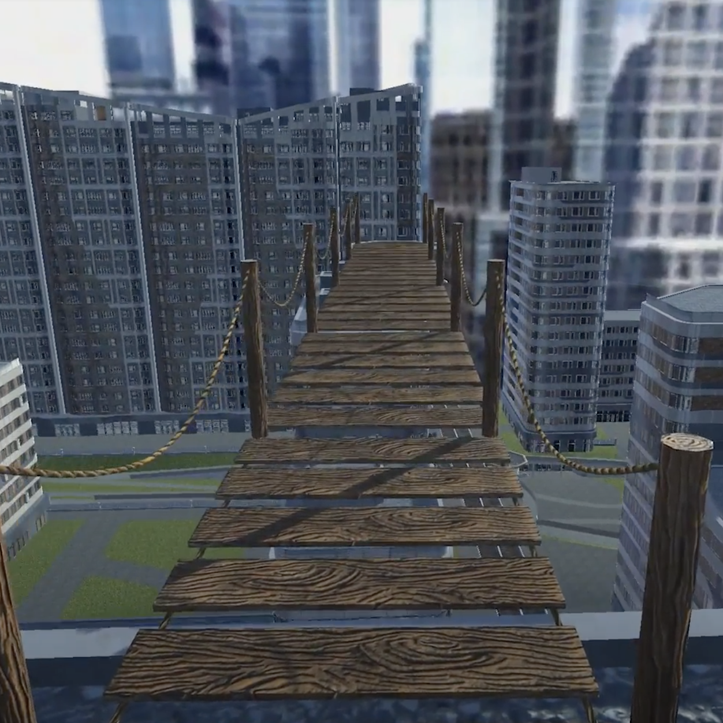
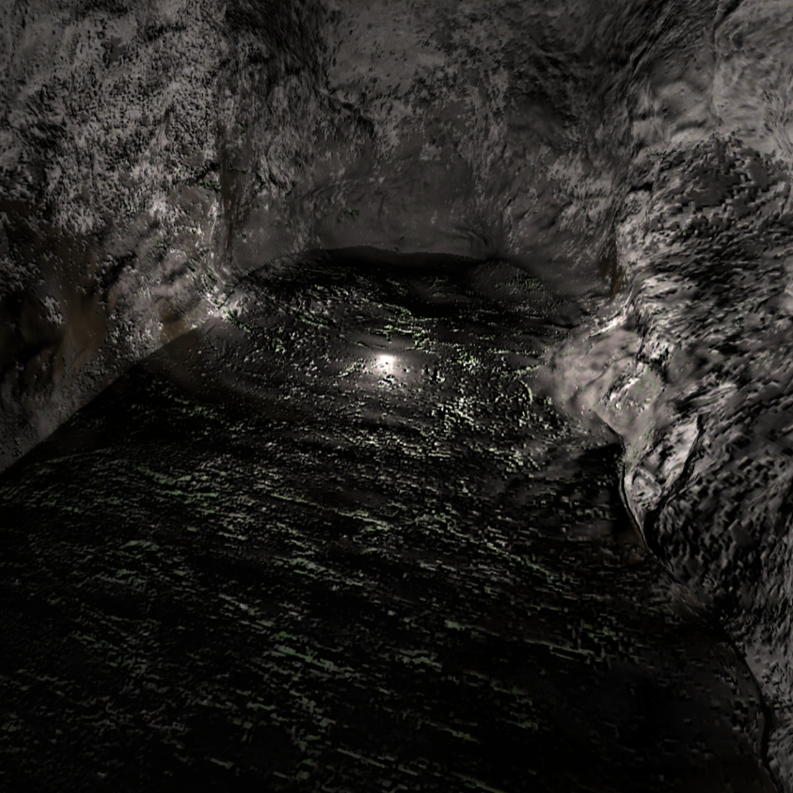
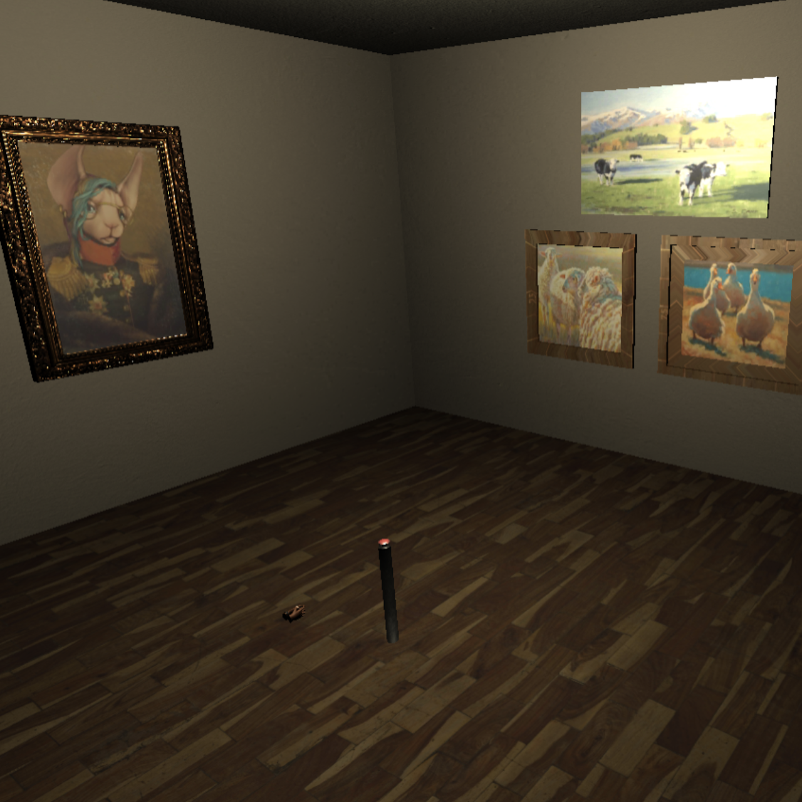
Phobigone
VR game application to help users overcome their phobias (fear of the dark, heights, small spaces).
VR Game Development
Game Design
User Research
Teamwork
Unity
Blender
Users collect a star in each level to progress.
Designed the heights and claustrophobia levels for maximum immersion.
Conducted pre/post-user testing and surveys — surprisingly, some users developed new fears, reinforcing the need for early UX testing.

Slide 7
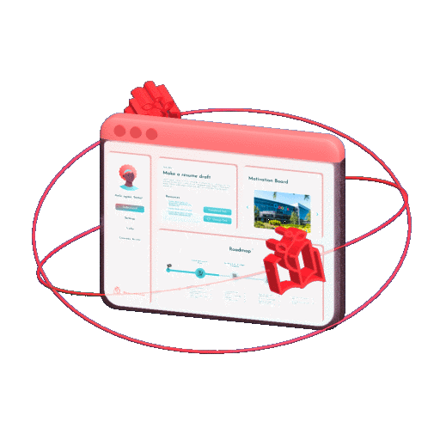
BalanceBuddy
Gamified website to balance between students’ schoolwork & job search process.

Slide 8
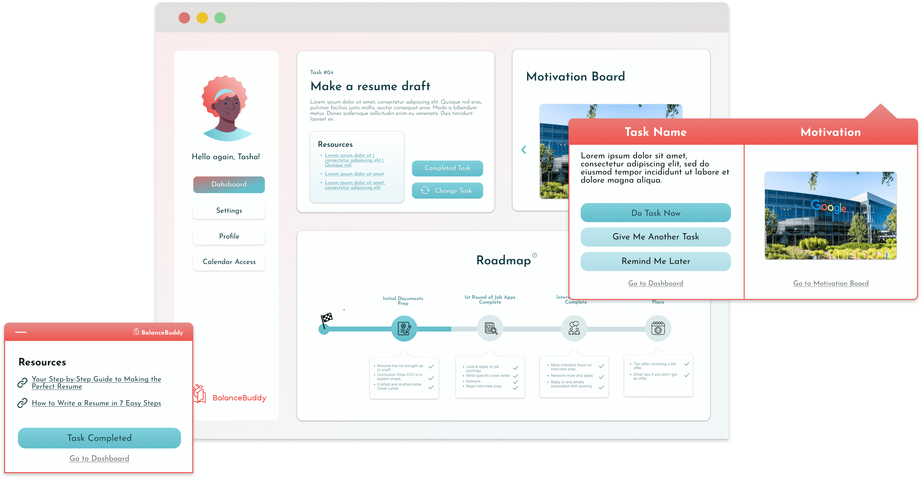
BalanceBuddy
Gamified website to balance between students’ schoolwork & job search process.
Web Development
UI/UX
User Research
Teamwork
Figma
Features
Daily motivational tasks.
Roadmap with their progress in the job search process.
Visual gallery of motivational images tied to progress.
Notification sent via web-browser extension.
My Role
Designed and tested UX prototypes in Figma.
Back-end development with React and MongoDB.
Built a browser extension for daily task pop-ups.

Slide 9
Thank you!

